Slide 1
Overview
Introduction
Data representation
Fixed Point Representation
    Integer Representation
Floating Point Representation
    Normalization

Slide 2
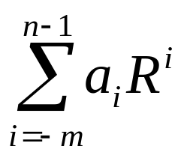
Introduction
Data
Numeric data - numbers(integer, real)
Non-numeric data - symbols, letters
Number System
Non-positional number system
- Roman number system
Positional number system
- Each digit position has a value called a weight associated with it
- Decimal, Octal, Hexadecimal, Binary
Base (or radix) R number
  Uses R distinct symbols for each digit
  Example A_{R} = a_{n-1} a_{n-2} ... a₁ a₀ . a₋₁…a_{-m}
V(A_{R} ) =
Radix point(.) separates the integer
portion and the fractional portion
R = 10 Decimal number system R = 2 Binary
R = 8 Octal, R = 16 Hexadecimal

Slide 3
Representation of Positional Numbers
Decimal Binary Octal Hexadecimal
00 0000 00 0
01 0001 01 1
02 0010 02 2
03 0011 03 3
04 0100 04 4
05 0101 05 5
06 0110 06 6
07 0111 07 7
08 1000 10 8
09 1001 11 9
10 1010 12 A
11 1011 13 B
12 1100 14 C
13 1101 15 D
14 1110 16 E
15 1111 17 F

Slide 4


Decimal representation:
Binary code
BCD: binary-coded decimal (BCD) is a class of binary encodings of decimal numbers where each decimal digit is represented by a fixed number of bits, usually four or eight.
Types of BCD
Unpacked: each numeral is encoded into one byte, with four bits representing the numeral and the remaining bits having no significance. For ex:
Packed: two numerals are encoded into a single byte, with one numeral in the least significant nibble (bits 0 through 3) and the other numeral in the most significant nibble (bits 4 through 7). For ex:

Slide 5
Alphanumeric representation: includes 10 decimal digits, the 26 letters of alphabet and a number of special character such as !@#$%^
ASCII code: which uses seven bit to code 128 characters

Slide 6
COMPLEMENT OF NUMBERS
Two types of complements for base R number system:
- R's complement and (R-1)'s complement
- 1’s and 2’s compliment for binary numbers and 9’s and 10’s compliment for decimal numbers
The (R-1)'s Complement
Subtract each digit of a number from (R-1) Example
- 9's complement of 835₁₀ is 164₁₀
- 1's complement of 1010₂ is 0101₂(bit by bit complement operation)
The R's Complement
Add 1 to the low-order digit of its (R-1)'s complement
Example
- 10's complement of 835₁₀ is 164₁₀ + 1 = 165₁₀
- 2's complement of 1010₂ is 0101₂ + 1 = 0110₂

Slide 7
Fixed Point Representation
Numbers: Fixed Point Numbers and Floating Point Numbers
Binary Fixed-Point Representation
X = x_{n}x_{n-1}x_{n-2} ... x₁x₀. x₋₁x₋₂ ... x_{-m}
Sign Bit(x_{n}): 0 for positive - 1 for negative
Remaining Bits(x_{n-1}x_{n-2} ... x₁x₀. x₋₁x₋₂ ... x_{-m})

Slide 8
Fixed Point Representation
Representation of both positive and negative numbers
- Following 3 representations
Signed magnitude representation
Signed 1's complement representation
Signed 2's complement representation
Example: Represent +9 and -9 in 7 bit-binary number
Only one way to represent + 9 ==> 0 001001
Three different ways to represent - 9:
  In signed-magnitude: 1 001001
  In signed-1's complement: 1 110110
  In signed-2's complement: 1 110111
Fixed point numbers are represented either integer part only or fractional part only.

Slide 9
Floating Point Representation
The location of the fractional point is not fixed to a certain location
The range of the represent able numbers is wide
F = EM
m_{n} e_{k}e_{k-1} ... e₀ m_{n-1}m_{n-2} … m₀ . m₋₁ … m_{-m}
sign exponent mantissa
- Mantissa
Signed fixed point number, either an integer or a fractional number
- Exponent
Designates the position of the radix point
V stands for Value
M: Mantissa
E: Exponent
R: Radix
Decimal Value
V(F) = V(M) * R^{V(E)}

Slide 10
Floating Point Representation
Example
sign
sign
0
.1234567
0
04
mantissa
exponent
==> +.1234567 x 10⁺⁰⁴
Note:
In Floating Point Number representation, only Mantissa(M) and Exponent(E) are explicitly represented. The Radix(R) and the position of the Radix Point are implied.
Example
A binary number +1001.11 in 16-bit floating point number representation
(6-bit exponent and 10-bit fractional mantissa)
0 000100 100111000
0 000101 010011100
or
Sign
Exponent
Mantissa

Slide 11
Floating Point Representation-Normalization
A Floating Point number is said to be normalized if the most significant digit of the mantissa is nonzero
E.g. Binary number 00011010 is not normalized

Slide 12
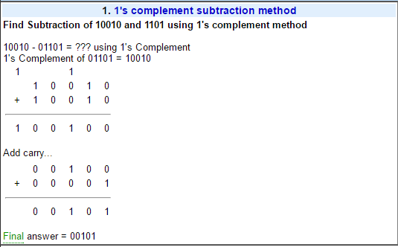

Slide 13
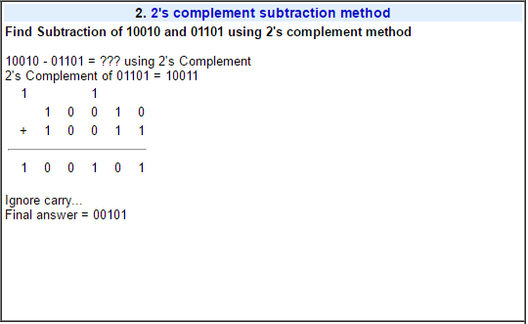

Slide 14
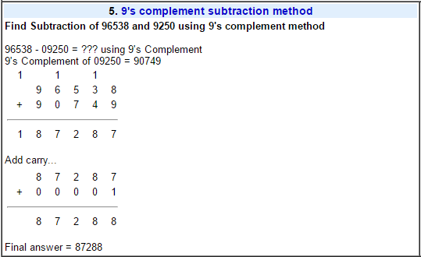

Slide 15
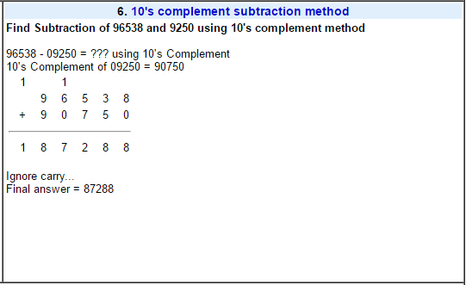

Slide 16
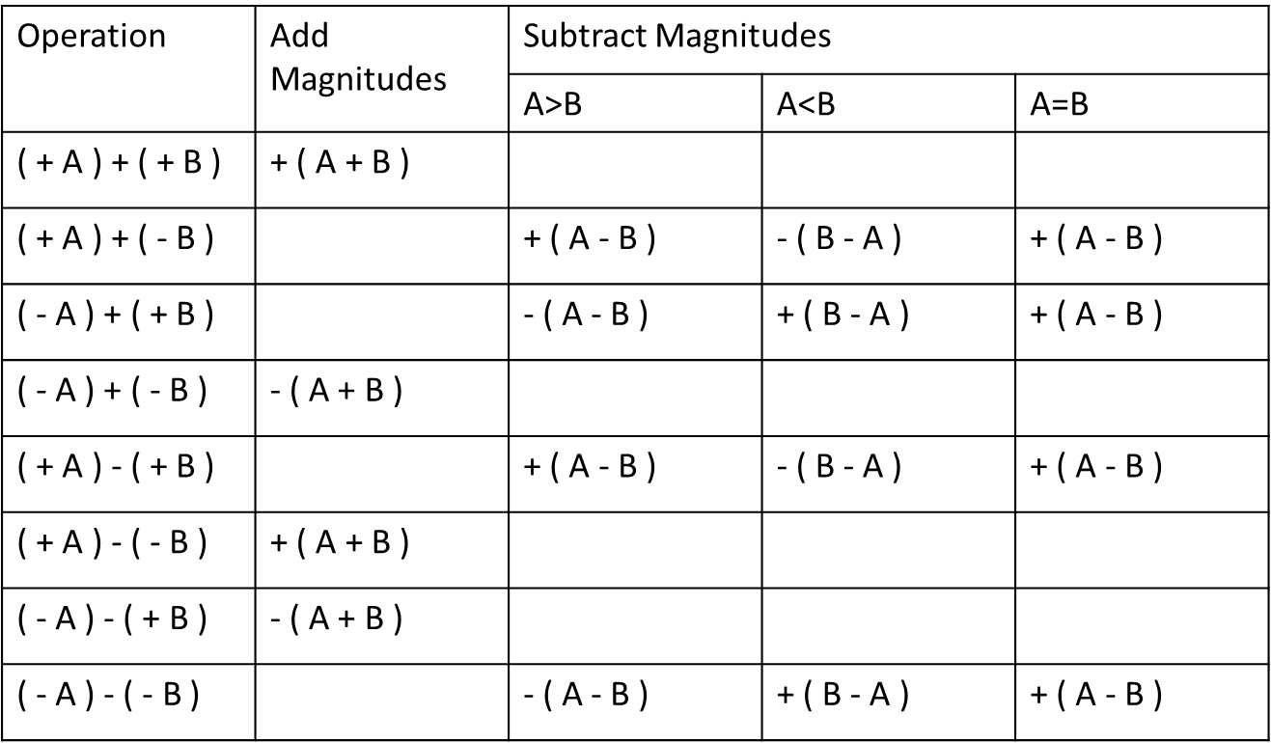
Addition and Subtraction with Signed Magnitude Data

